Slide 1
Kubernetes Explained
Session 3
Diego Casati, Cloud Solution Architect
Alice Gibbons, Cloud Native Global Black Belt

Slide 2


Who we are
Alice Gibbons
Technical Specialist
Cloud Native Global Black Belt Team
Calgary, Alberta
Diego Protta Casati
Cloud Solution Architect
One Commercial Partner Team
Calgary, Alberta

Slide 3
Kubernetes Explained: 3 Part Series
Session One
Session Two
Session Three
1
2
3
Sept 23, 1-4pm PDT
Docker & Kubernetes Basics
Sept 30, 1-4pm PDT
Azure Kubernetes Service deep dive, Helm & Secrets
Oct 7, 1-4 PDT
Day 2 Operations: Security Monitoring & Scaling
Notes:
Session 1 (Sept. 9)
Basics of containerization/orchestration
Introduction to AKS
Demo example cluster
Kubectl demo
Introduction to the Demo Example Scenario (usable across all 3 workshops)

Slide 4
Agenda
Quick Recap
Namespaces
Network Policies
Monitoring: Azure Monitor for Containers
Scaling
Updates & Upgrades
Q&A
MS Learn Modules
Slides
https://github.com/alicejgibbons/kubernetes-explained

Slide 5
Quick Recap

Slide 6
Kubernetes 101
Internet
Kubernetes control
Worker node
Kubernetes users communicate with API server and apply desired state
kubelet
kube-proxy
Master node
Docker
Master nodes actively enforce desired state on worker nodes
Pod
Pod
API server
Containers
Containers
Worker nodes support communication between containers
-controller-manager
-scheduler
Worker node
kubelet
kube-proxy
Worker nodes support communication from the Internet
replication, namespace, serviceaccounts, etc.
etcd
Docker
Pod
Pod
Containers
Containers

Slide 7
How managed Kubernetes on Azure works
Automated upgrades, patches
High reliability, availability
Easy, secure cluster scaling
Self-healing
API server monitoring
At no charge
Azure managed control plane
App/ workload definition
Self-managed master node(s)
Kubernetes API endpoint
etcd Store
User
API server
Scheduler
Controller Manager
Cloud Controller
Schedule pods over private tunnel
Customer VMs
Docker
Docker
Docker
Docker
Docker
Pods
Pods
Pods
Pods
Pods

Slide 8


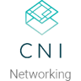



















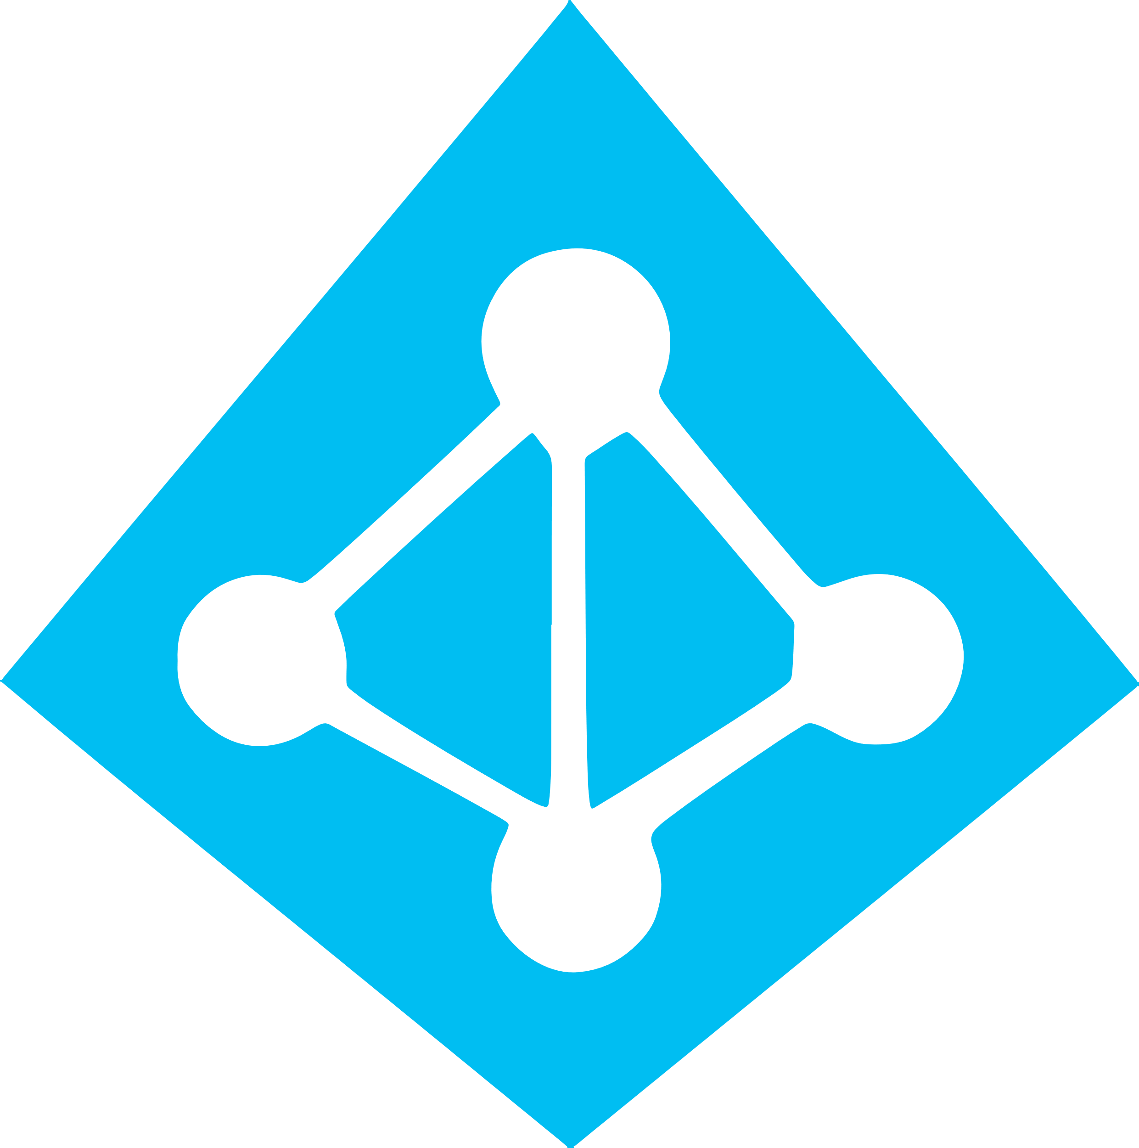


Work how you want with opensource tools and APIs
 | Development | DevOps | Monitoring | Networking | Storage | Security
Take advantage of services and tools in the Kubernetes ecosystem
OR, Leverage growing Azure support
RBAC
Azure Container Registry
AAD
Key Vault
VSTS
ARM
VS Code
Azure Monitor
Azure VNET
Azure Storage

Slide 9
Namespaces
Notes:
How to monitor Kubernetes workloads with Azure Monitor for Containers
https://www.youtube.com/watch?v=XEdwGvS2AwA

Slide 10
Namespaces
Demo 1

Slide 11
Kubernetes 101
Internet
Kubernetes control
Worker node
The Kubernetes network is a flat network
kubelet
kube-proxy
Master node
Docker
All objects can see each other
Client1
Client1
API server
Containers
Containers
-controller-manager
-scheduler
Worker node
kubelet
kube-proxy
replication, namespace, serviceaccounts, etc.
etcd
Docker
Client2
Client2
Containers
Containers

Slide 12
Kubernetes 101
Internet
Kubernetes control
Worker node
The Kubernetes network is a flat network
kubelet
kube-proxy
Master node
Docker
All objects can see each other
Client1
Client1
API server
Containers
Containers
Using namespace, you can group objects
-controller-manager
-scheduler
Worker node
kubelet
kube-proxy
replication, namespace, serviceaccounts, etc.
etcd
Docker
Client2
Client2
Containers
Containers

Slide 13

Kubernetes 101
Internet
Kubernetes control
Worker node
The Kubernetes network is a flat network
kubelet
kube-proxy
Master node
Docker
All objects can see each other
Client1
Client1
API server
Containers
Containers
Using namespace, you can group objects
-controller-manager
-scheduler
Worker node
kubelet
kube-proxy
Using network policies, you can restrict access
replication, namespace, serviceaccounts, etc.
etcd
Docker
Client2
Client2
Containers
Containers
Notes:
Namespaces are a way to divide cluster resources between multiple users (via resource quota).

Slide 14


East/West Traffic with Network Policy
Control network traffic within the cluster
Restrict pod⬄ pod communication in a cluster
Choice of plugins:
Azure-native
OSS Calico project
Kubernetes cluster
Notes:
Calico network policy provides a richer set of policy capabilities than Kubernetes including: policy ordering/priority, deny rules, and more flexible match rules. While Kubernetes network policy applies only to pods, Calico network policy can be applied to multiple types of endpoints including pods, VMs, and host interfaces. Finally, when used with Istio service mesh, Calico network policy supports securing applications layers 5-7 match criteria, and cryptographic identity.
You can use Calico network policy in addition to Kubernetes network policy, or exclusively. For example, you could allow developers to define Kubernetes network policy for their microservices. For broader and higher-level access controls that developers cannot override, you could allow only security or Ops teams to define Calico network policies.

Slide 15
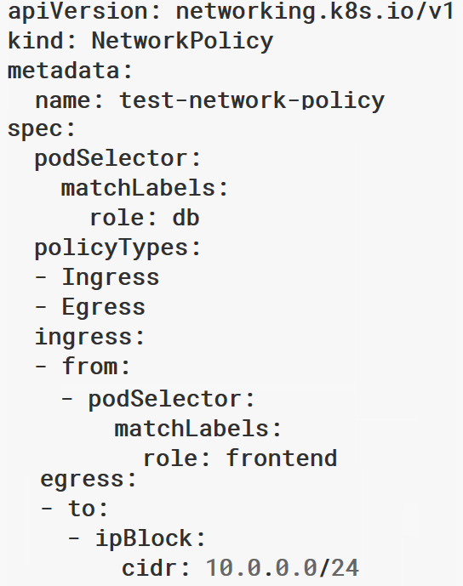
East/West Traffic in AKS with Network Policy
Recommend to create default policies that apply to all pods
Default deny all ingress traffic
Default deny all egress traffic
Allow Pod to Pod Communication in a Namespace
Allow Specific Traffic (Ingress & Egress) Across Namespaces
Kubernetes cluster

Slide 16
Monitoring
Notes:
How to monitor Kubernetes workloads with Azure Monitor for Containers
https://www.youtube.com/watch?v=XEdwGvS2AwA

Slide 17
Common container monitoring pain points
Is my cluster healthy?
“I am having an issue
with my application but cannot see any issues?“
Troubleshooting Guidance
“many tools have nice graphs but does not
help where to go to troubleshoot next”
“I want to dig within the cluster but have filter to focus on my workloads.”
Drill down experience with filters
“if I am using Azure, can Microsoft provide monitoring tools for me?”
“I don’t want my devs to touch kubectl commands. It is another tool with additional learning.”
Lower
Maintenance
Cost
Native Monitoring Experience
Usability and
Control
“I know OSS monitoring products, but I want to focus on my products rather maintaining monitoring tools.”

Slide 18



Azure Monitor for containers
Azure Monitor for containers
Prometheus
Get detailed insights about your workloads with Azure Monitor
Cloud native experience for Azure Monitor with Prometheus integration
Observe live container logs and Kubernetes event log on container deployment status
Filter for details about nodes, controllers, and containers
Visualization
2
Visualize overall health and performance from cluster to containers with drilldowns and filters
Azure Kubernetes Service
See graphical insights about clusters
Azure Pipelines
Observability
Pull events and logs for detailed activity analysis
1
Insights
3
Provide insights with cluster health rollup view
Monitor & analyze
4
Monitor and analyze Kubernetes and container deployment performance, events, health, and logs
Virtual node
Response
Native alerting with integration to issue management and ITSM tools

Slide 19
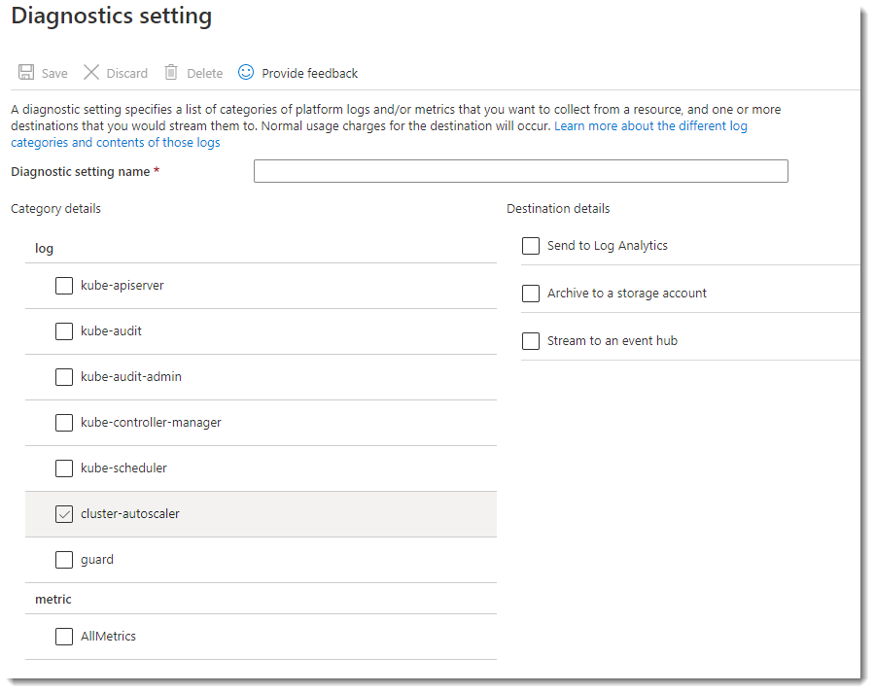
Enable Control plane logs
Use the Azure portal to enable diagnostics logs
Pipe logs to Log Analytics, Event Hub or a storage account

Slide 20
Logging and key metrics
File logging?
Better to log everything to stdout/stderr
Key metrics
Node metrics (CPU Usage, Memory Usage, Disk Usage, Network Usage)
kube_node_status_condition
Pod memory usage / limit
container_memory_failures_total, container_memory_working_set_bytes
Pod CPU usage average / limit
Filesystem Usage / limit
Network receive / transmit errors
Notes:
Best practice -> stdout/stderr
Node metrics as well as pod metrics
Node: cpu, mem, disk, network
Pod: mem, failures, average cpu usage’
Filesystem usage, ntwk errors

Slide 21
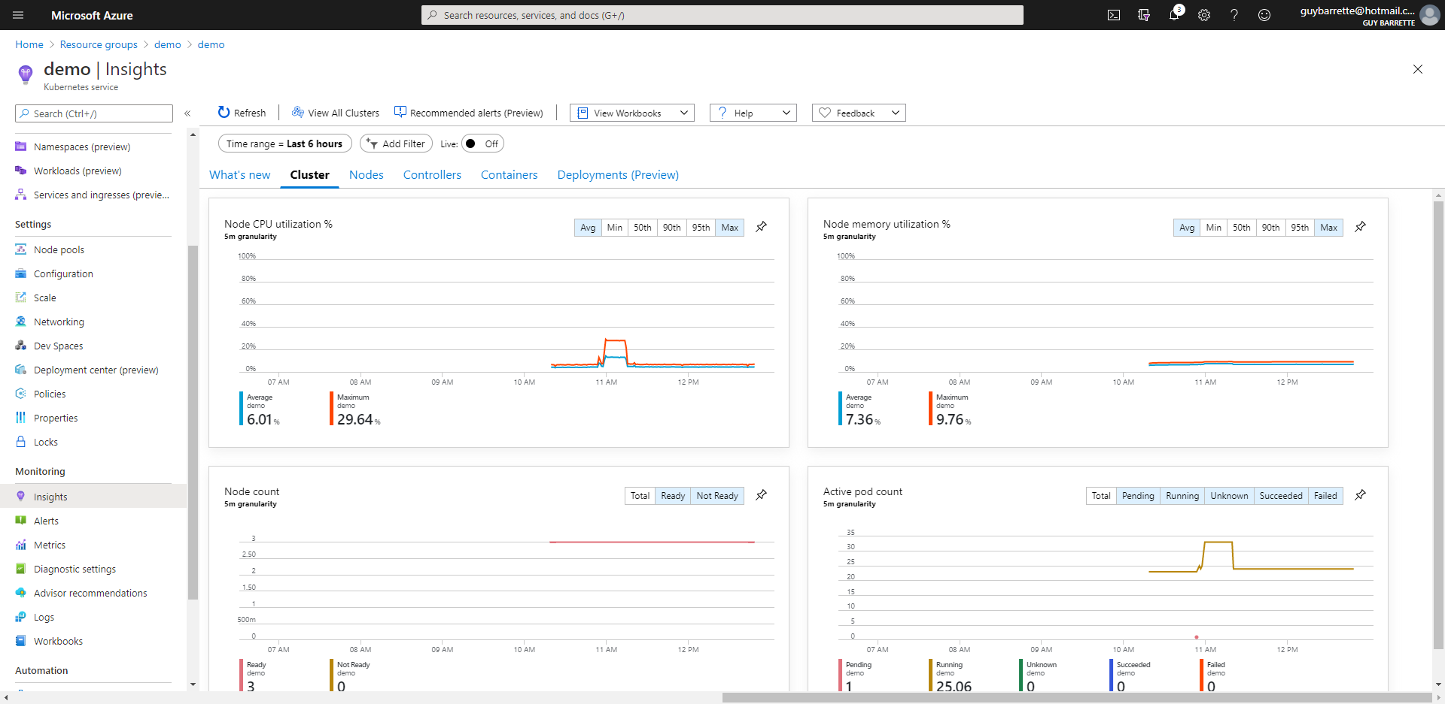
Overview of AKS cluster health

Slide 22
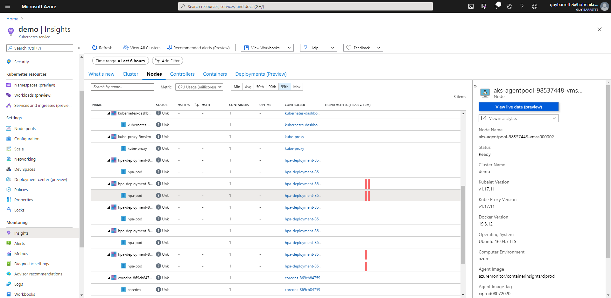
Node event logs
Notes:
Kuscto query language
Node logs – events on the node

Slide 23
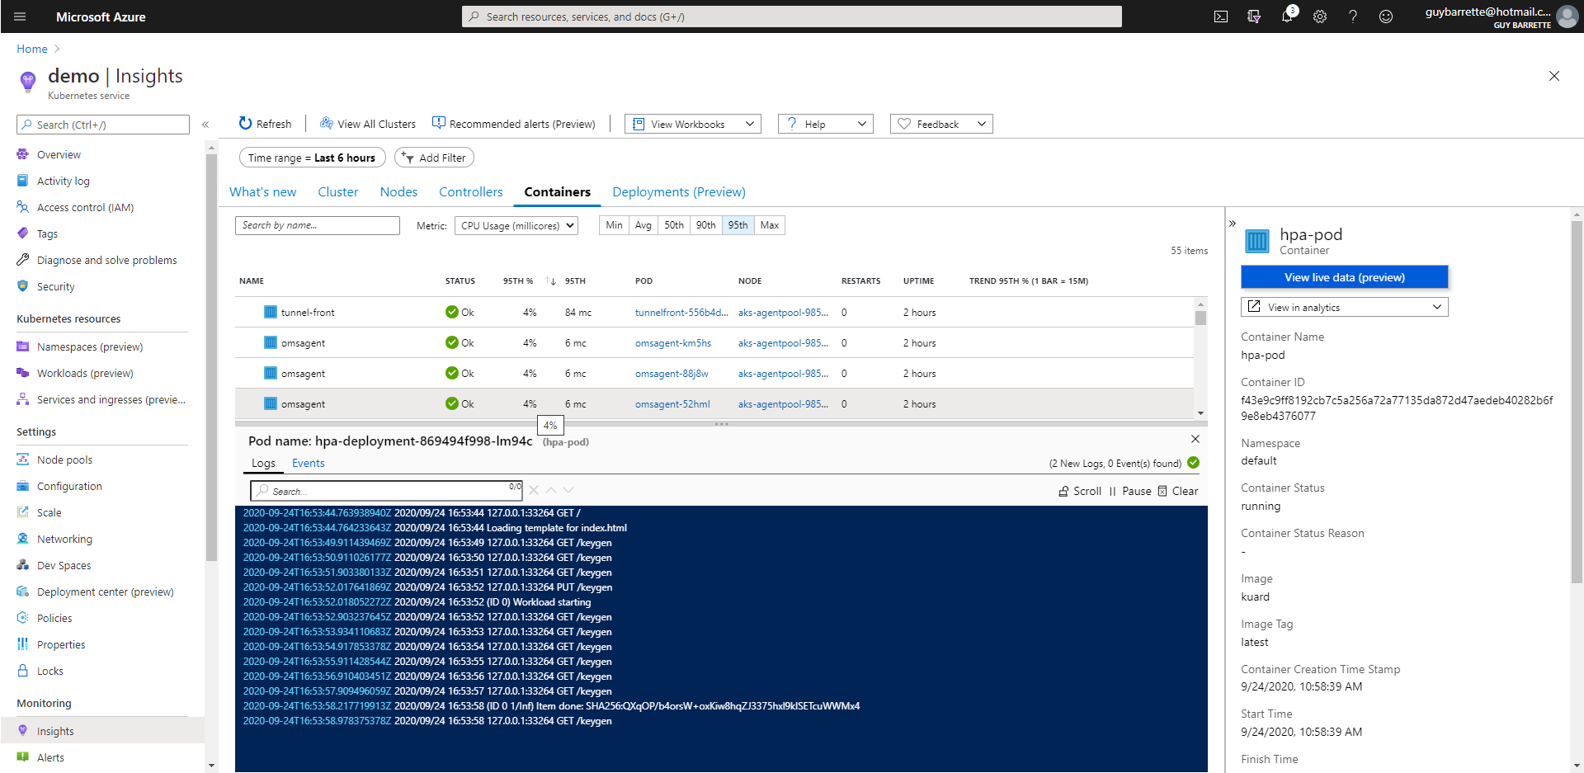
Pod usage and details
Notes:
Azure Monitor does not gather logs (stdout) from Windows containers. You can still attach to the live stream of stdout logs from a Windows container – on the roadmap

Slide 24
Azure Monitor for Containers
Demo 2

Slide 25
Scaling
Notes:
Diego from here on

Slide 26
Horizontal Pod Autoscaler
The horizontal pod autoscaler (HPA) uses the Metrics Server in a Kubernetes cluster to monitor the resource demand of pods. If a service needs more resources, the number of pods is automatically increased to meet the demand.
͏HPA obtains resource metrics and compares them to user-specified threshold
2
Node1
Horizontal Pod Autoscaler
Pod
3
Deployment
ReplicaSet
͏HPA evaluates whether user specified threshold is met or not
replicas++
Kubelet
replicas--
4
cAdvisor
Pod
͏HPA increases/decreases the replicas based on the specified threshold
Grabs metrics
1
NodeX
͏The Deployment controller adjusts the deployment based on increase/decrease in replicas
Metrics Server
Node2
Pod
Collects metrics from all containers on the node
Kubelet
Collects metrics from all nodes
cAdvisor

Slide 27
Cluster Autoscaler
The cluster autoscaler watches for pods that can't be scheduled on nodes because of resource constraints. The cluster then automatically increases the number of nodes.
͏HPA obtains resource metrics and compares them to user-specified threshold
Cluster Autoscaler
Azure
Pod
Pod
2
1
͏HPA evaluates whether user specified threshold is met or not
Additional nodes needed
Pods are in pending state
͏HPA increases/decreases the replicas based on the specified threshold
3
Pending pods are scheduled
Node is granted
4
͏The Deployment controller adjusts the deployment based on increase/decrease in replicas
AKS cluster
Node
Node
Pod
Pod
Pod
Pod

Slide 28
Azure Monitor HPA, Node Scaling
Demo 2
Demo 3

Slide 29
Updates & Upgrades

Slide 30
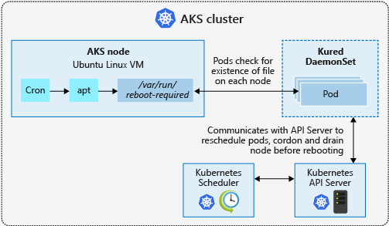
Process Node OS updates
AKS automatically applies security patches to the nodes on a nightly schedule for Linux nodes
Windows nodes must be upgraded to get latest fixes and updates
You’re responsible to reboot as required
Regular maintenance recommended
Monthly ideal, 3 months minimum
Use Kured DaemonSet to watch for nodes requiring a reboot and handle the reschedule of the pods and reboot of the nodes. Check AKS documentation for guidance to use Kured
Notes:
Windows Server nodes in AKS must be upgraded to get the latest patch fixes and updates.
Windows Updates are not enabled on nodes in AKS. AKS releases new node pool images as soon as patches are available, it is the customers responsibility to upgrade node pools to stay current on patches and hotfix.
This is also true for the Kubernetes version being used. AKS release notes will indicate when new versions are available.
Kured only for Linux rn – windows containers coming, theres a PR on this

Slide 31
Cluster Upgrade
Upgrade to version 1.11.4
$ az aks upgrade --name myAKSCluster --resource-group myResourceGroup --kubernetes-version 1.11.4
The Kubernetes community releases minor versions roughly every three months
AKS supports *4* minor versions of Kubernetes
The latest stable version upstream and the previous 3
Each supported minor version also supports *2* stable patches.
Notes:
1.18.1(preview) 1.18.2(preview)
1.17.3(preview) 1.18.1(preview), 1.18.2(preview)
1.16.7 1.17.3(preview)
1.15.10 1.16.7
1.15.7 1.15.10, 1.16.7
1.14.8 1.15.7, 1.15.10
1.14.7 1.14.8, 1.15.7, 1.15.10\
- Goes to the bigger regions first but usually gets rolled out pretty quick to other regions

Slide 32
Upgrades
Demo 4

Slide 33
Learning AKS

Slide 34
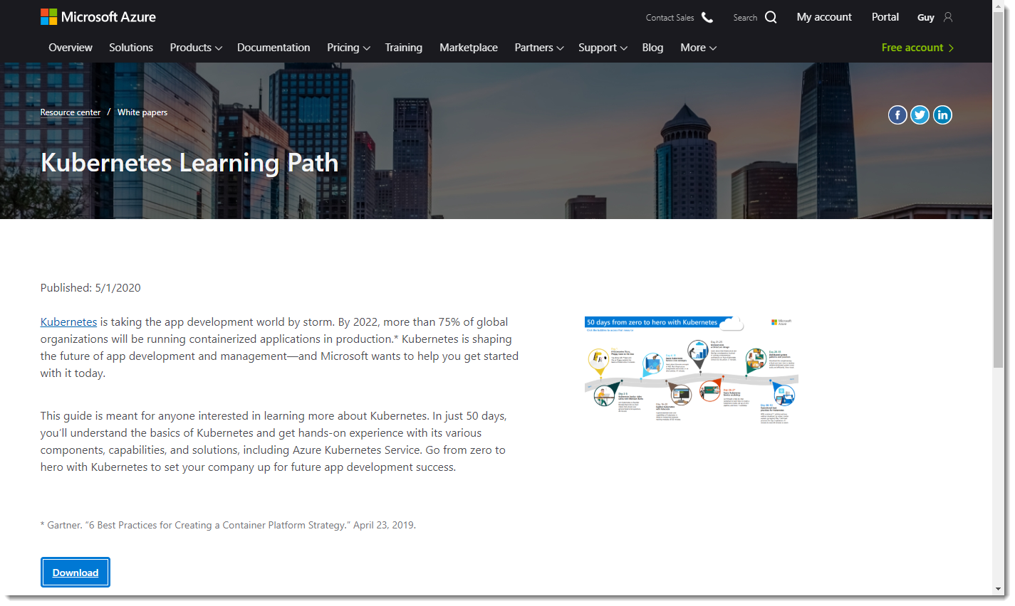
Learn Kubernetes
https://aka.ms/learnkubernetes

Slide 35
Hands on Content: Modules 5-6
https://aka.ms/kubernetesexplained-1
GitHub Link: Today’s Apps & Slides
https://github.com/alicejgibbons/kubernetes-explained

Slide 36
Q&A

Slide 37
Thank You

